Slide 1
Surface Simulation: A microscopic insight that challenges the macroscopic view
By: Stanley Lo
Feel free to interrupt and ask me questions!

Slide 2
Outline page
Intro
Background info:
What?
Evaluating the energies of the bacteria attaching onto which location of the surface and how the bacteria configures itself (lowest energy wins)
Bacteria membrane composition (mostly negative)
Surface Gradient
How bacteria composition is distributed
How bacteria interacts with surface
Rotations (make diagrams about how they rotate, in 2 different angles)
Energy Calculations
What equations are in place, the methods (binary search)
Why?
To view microscopic phenomena and redefine how people think that macroscopic properties may govern the whole story
Discussion:
Trends from different bacteria arrangements interacting with the surface
Different conditions (large, small domains)
Next Steps:
Real experiments, Size of Surface, Different sizes of domain

Slide 3
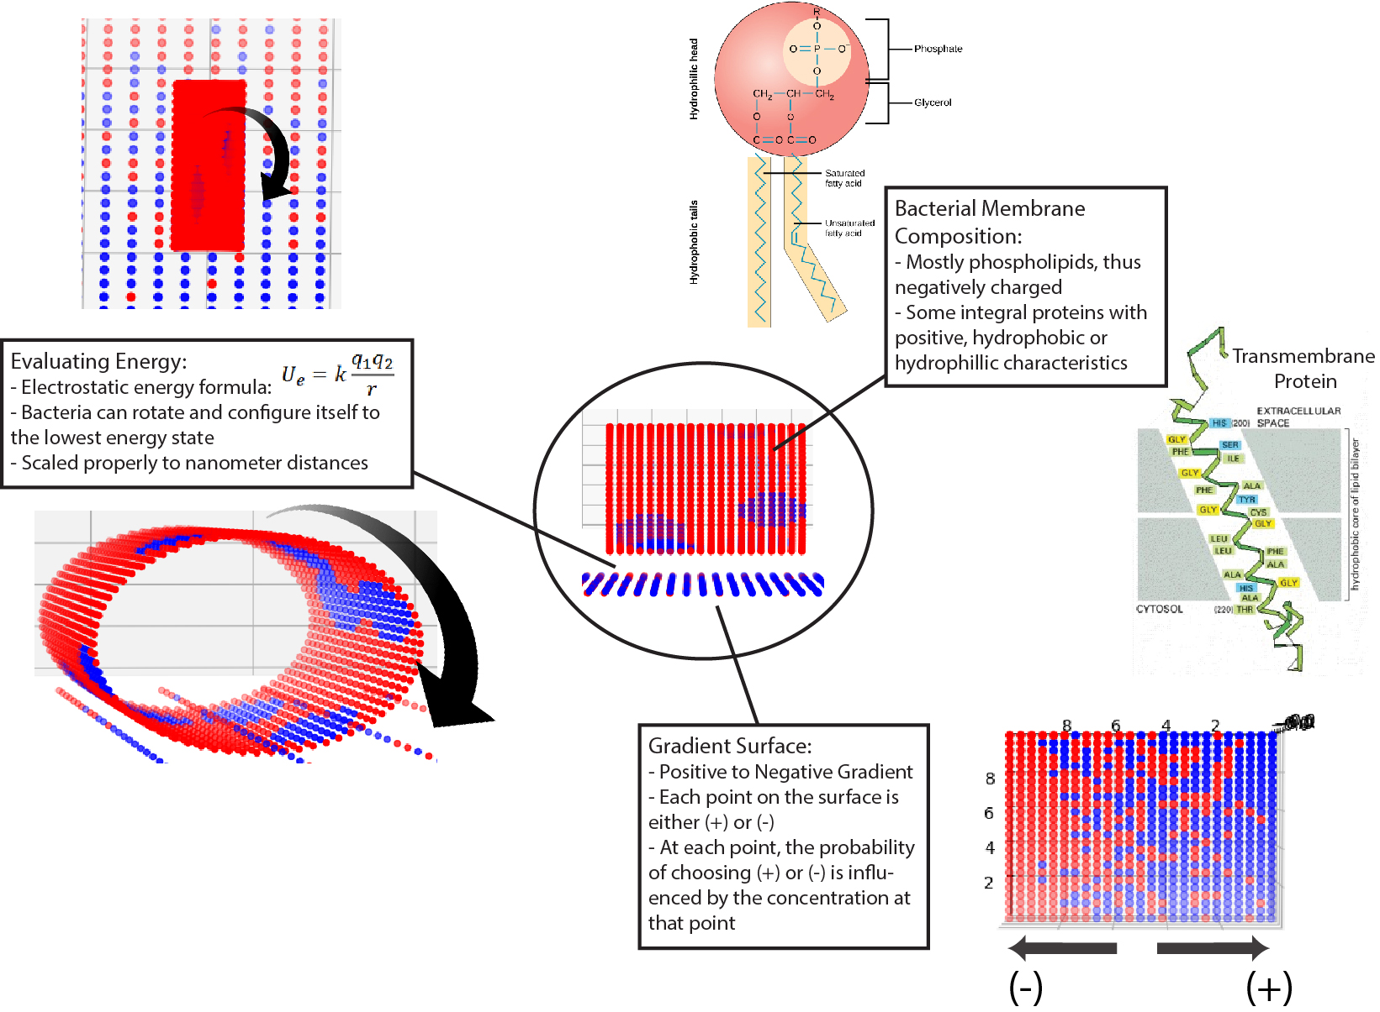
Background Info
Y
X
Why?
To view microscopic phenomena and redefine how people think that macroscopic properties may govern the whole story

Slide 4
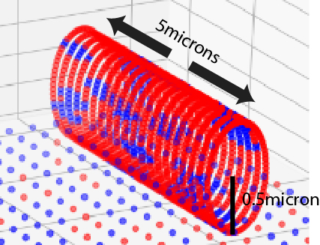
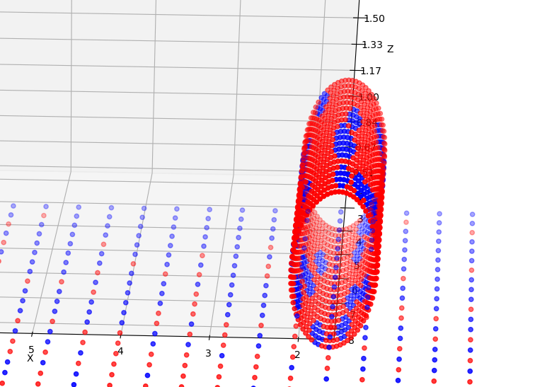

The Coding Side – Bacterial Membrane
Preliminary Experiment:
Concentration: (+) = 30%, (-) = 70%
The positive domains are octagons which are positioned randomly on the bacteria’s membrane which can result in overlapping domains
Using a different # for np.random.seed(#), will generate different randomness, making different bacteria
Radius: 0.5 micron, Length: 5 micron, Height above Surface: 1 nanometer, Total Points on the Bacteria: 1440 pts, 20 Circles composed of 72 points, Distance between each circle: 0.25 micron
Tested 2 sizes of domains: 12pts / domain, 37pts / domain
Small Domain
Large Domain

Slide 5
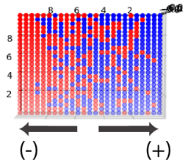
The Coding Side – Gradient Surface
Same gradient surface for all experiments (np.random.seed.(1) keeps randomness constant)
Each vertical line of points is given a probability that correlates to its desired concentration
With that probability, the points randomly choose whether it is (+) or (-) but it is biased with the probability
Size: 10x10 microns
Resolution: 25x25 points = 625 points

Slide 6
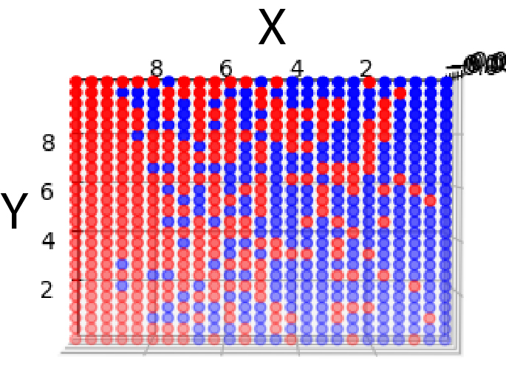
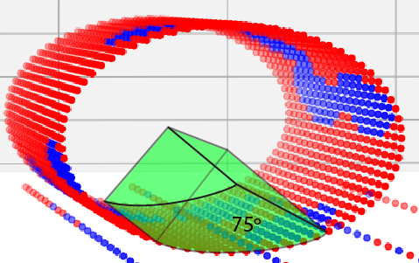
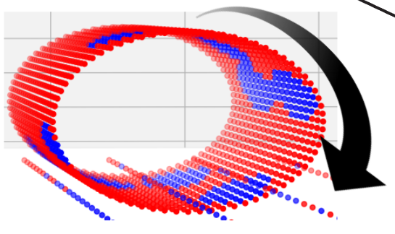
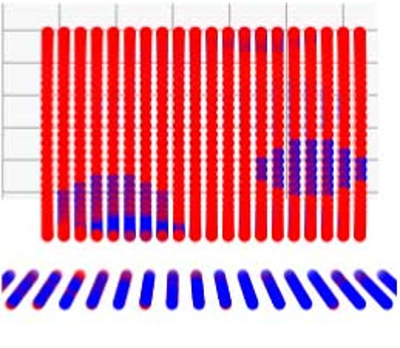
The Coding Side – Evaluating Energies
Steps to evaluating the entire surface:
Translational
Moves by intervals of 1/25 of size of surface (0.4 micron for a 10 micron surface)
Rotational
XY → Rotates by 36 degrees
Around cylinder’s axis → Rotates by every point (5 degrees)
Search Angle
Optimal angle is 75 degrees
Electrostatic Energy
Only calculates from the a point on the bacteria to the closest point on the surface
Uses binary search algorithm which cuts runtime from n to log(n)
Formula = (+1)(-1) / r OR (+1)(+1) / r
Sum of all the energies in the search angle area
Log all energies and find minimum energy

Slide 7
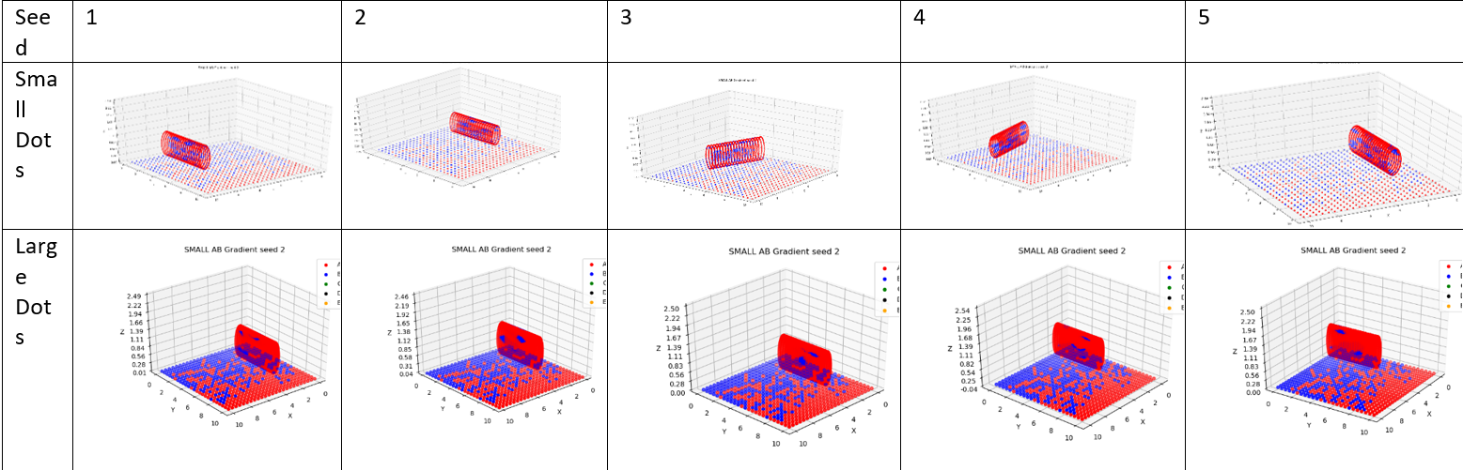
Experiments!
Changing Variables:
From sample to sample → Different arrangement of domains on bacteria
From independent variable to independent variable → Changing size of domain

Slide 8
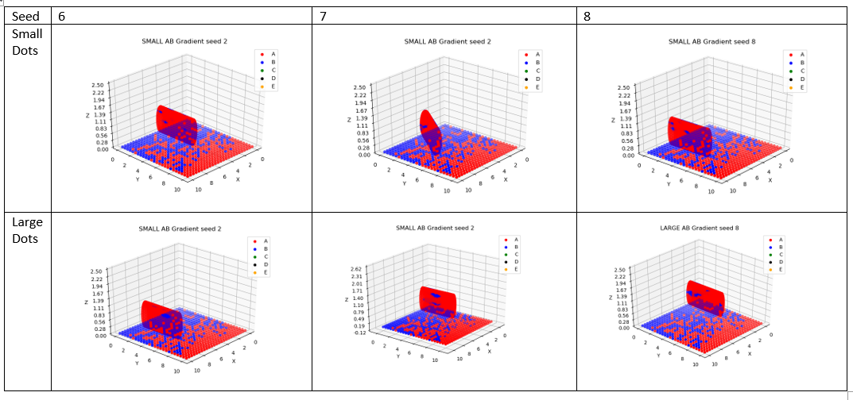
Experiments!
More Location Data
Interesting Discovery!
Small Domains interact with the surface with more flexibility, arranging itself in more interesting ways
Large Domains are mostly in one fixed position, and always parallel to the gradient (it’s hard for them to find matching domains on the surface since it is a random gradient)

Slide 9
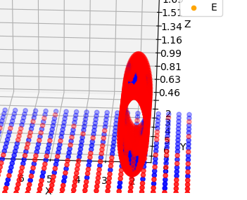
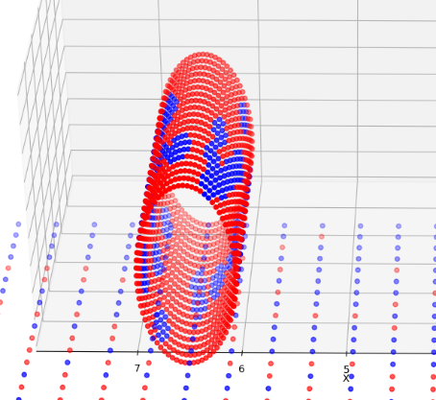
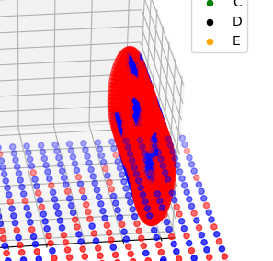
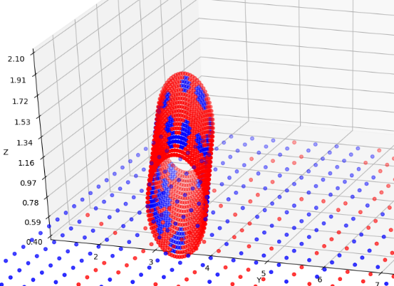
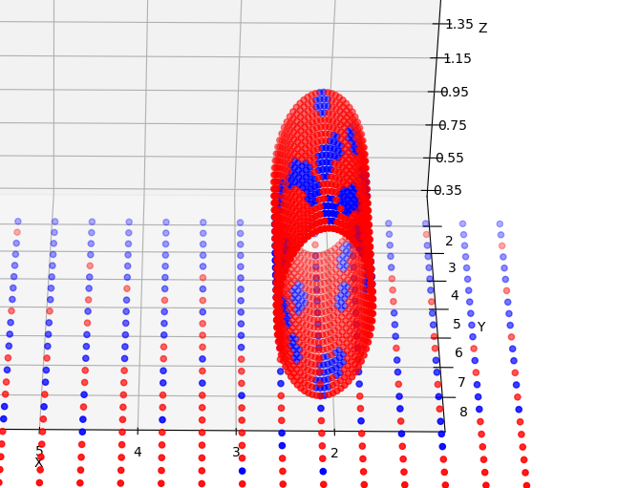
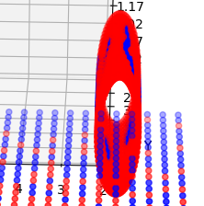
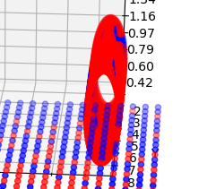
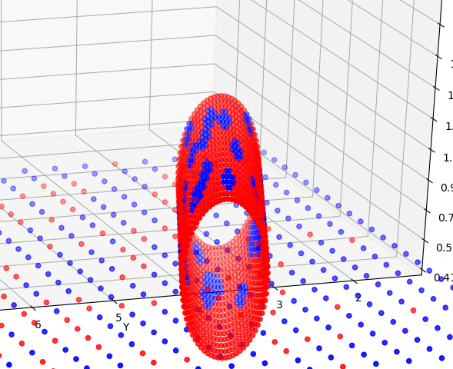
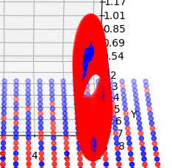
Experiments
Minimum Energy Values & Close-Up Picture
1
SMALL DOMAINS
1
LARGE DOMAINS
Seed | Small Domains | Large Domains
1 | -36713 | -39990
2 | -37347 | -37812
3 | -38213 | -39788
4 | -37640 | -38632
5 | -36381 | -38391
6 | -36610 | -39881
7 | -36754 | -38961
Avg | -37094 | -39065
4
4
2
2
5
5
3
3

Slide 10
Conclusions
The bacteria on average has a NEGATIVE surface charge, and intuitively it should bind to the area with the most POSITIVE surface
However, because of the microscopic characteristics (domains), the bacteria binds to the surface in ways that are unexpected as seen with the bacteria with SMALL domains
What’s NEXT?

Slide 11
Discussion
Live DEMO (if you have any questions)
Domain Sizes
Bacterial Membrane concentration
Other variables to change
Transferrable to REAL experiment
Smallest gradient that can be made is on a 1mmx1mm microtiter plate
Different surfaces
LOTS THAT CAN BE DONE!

